Slide 1
Rock paper scissors game in Python
Mohamed Firas Faisal

Slide 2
Contents
Introduction
Python
Initialising
First print statements
Time function
While loop
Input statement
Random function
If statements (all conditions explained)
Finishing if statement

Slide 3
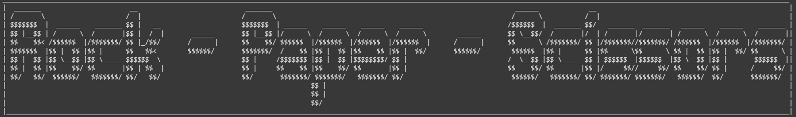
Introduction
This is a simple game of rock paper scissors written in python. It is a game that anyone can play. The rules are relatively simple, you chose one of the three options (rock, paper or scissors). Then the computer will also choose one of those three options.
The way you win:
Rock beats scissors (as in rock crushes the scissors)
Paper beats rock (paper will cover the rock and render it useless)
Scissors beat paper (scissors cut paper)
The code is written as such that it will count draws, incorrect inputs, how many times you have selected each weapon and output the number of wins and losses you have at the end
You will be prompted to put in if you want to continue the game or not
The code will also display how many times you have played the game (This is displayed after the prompt asking if the user wants to continue or not)

Slide 4

Python
A high-level, all-purpose programming language is Python.
Code readability is prioritized in its design philosophy, which makes heavy use of indentation. Python uses garbage collection and has dynamic typing.
It supports a variety of programming paradigms, such as functional, object-oriented, and structured programming.

Slide 5
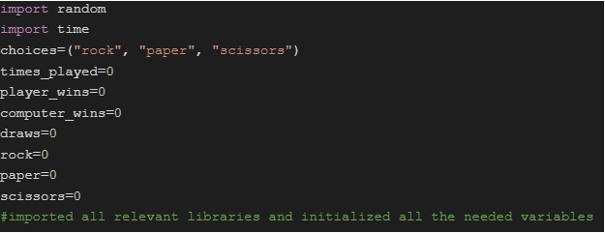
Initialising
First we will be importing all the relevant libraries and initiating all the variables and lists that will be used in the program.

Slide 6
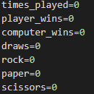
Counters
These are the variables that are used for counting (increasing by 1 every time the loop is run)
How many times the player has played
The number of wins
Number of losses
Number of draws
And the count of how many times the player used each weapon.

Slide 7
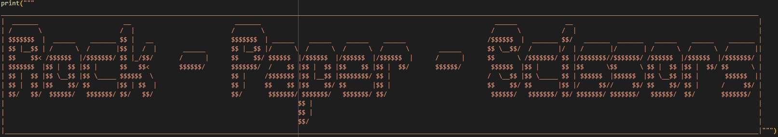
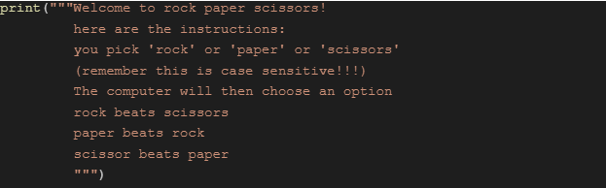
First print statements
This is the first outputs of the code
These are just simple print statements
Multi line print statements are used
The big display is made from an online ascii art generator

Slide 8
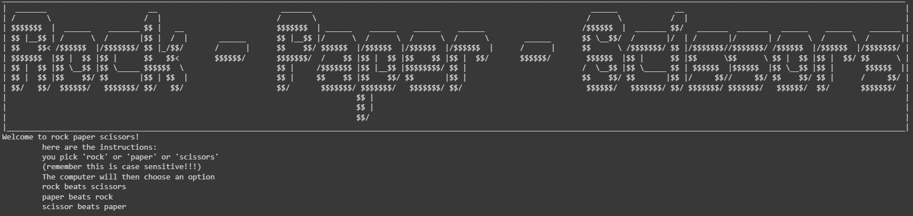
How the first print statements will look like

Slide 9

Time function
The time function is used to give the game a more natural feeling to it rather than the code doing everything in split seconds.
Some examples of the time function being used here:

Slide 10


While loop
The while loop is used so that the player can play the game however many times they want
The while loop end with a break statement

Slide 11


Input statements
These are used to input the users choice into the code
The user will be prompted to enter their choice of rock paper of scissors.
And also will be prompted to input yes or no to check if they want to continue to play the game
This is what will be seen:

Slide 12
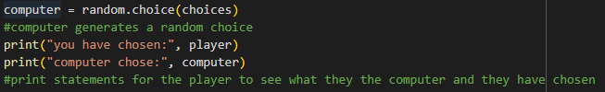
Random function
This is used in combination with the list names “choices” initialised earlier. This will assign the computer variable a random choice from the list everytime it runs through the loop

Slide 13
If statements
These are used to check if the player had won or not
They are conditional statements and they will only execute what is indented with them only if the condition of the code is true. Otherwise it will go onto the next if statement or the final else statement in the if/else if statements

Slide 14
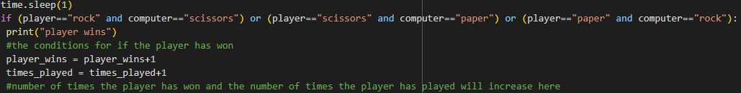
Conditions for the player winning
This is the conditions for the player winning. If this is true then it will output “player wins” and increase the win counter for the player and the number of times played

Slide 15

Condition for draw
If both the computer and player’s inputs are the same then it is counted as a draw
It will output “its a draw”
Increases the number of times played, increases the draw counter

Slide 16
Conditions for player loss
This is the conditions for the player losing. It will output “you lost player”
The computer win count is increased and the number of times played is also increased

Slide 17

Incorrect inputs
The else statement is there at the last because it does not fall into any other category of the if else statements and is regarded as an incorrect input

Slide 18
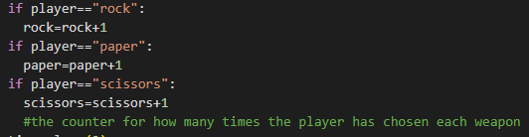
Weapon counter
Uses if statements to check and update the variables accordingly

Slide 19
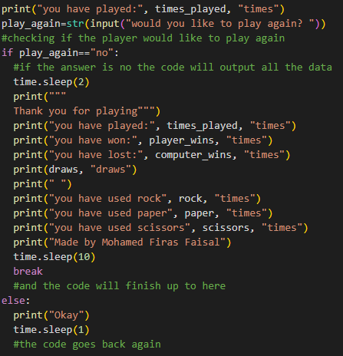
Finishing if statements
This is to check if the player wants to play the game again. It will prompt the user if they want to play again. If the input is no it displays all of the information and breaks the code
If the input is yes it will print “okay” and go back to the beginning of the while loop.

Slide 20
Thank you

